Slide 1

Phantastic Fungi
Team Members:
JuanCarlos Jimenez
Nolan McCarter
Matthew Rossi

Slide 2
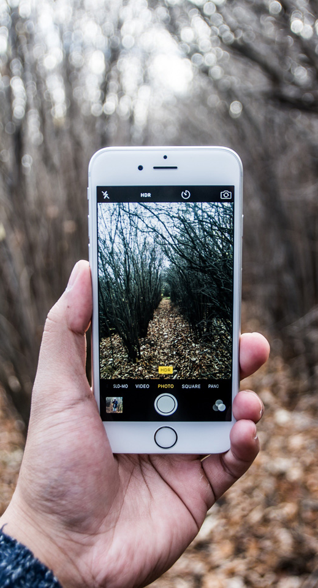
Phantastic Fungi
Upload a Photo from any device
Let our Computer Vision models work their magic
Receive information about any mushroom

Slide 3
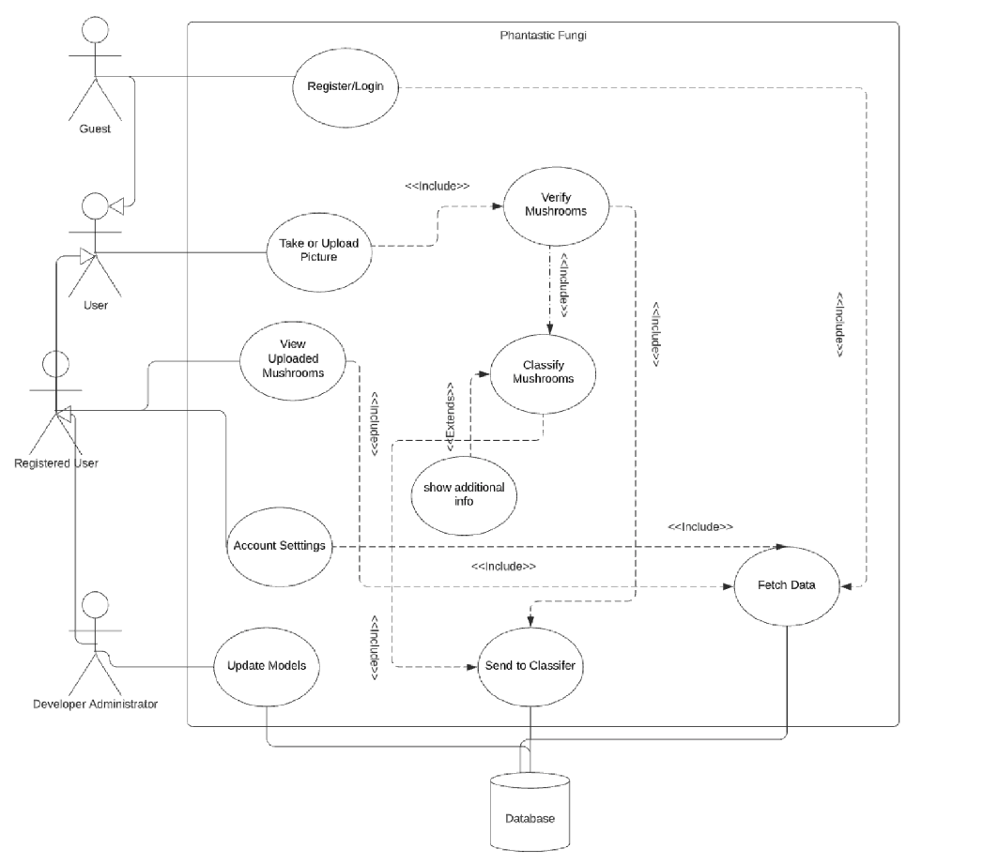
System Overview
Notes:
Use case diagram here

Slide 4
Actor Identification
User: A human actor that uses the application.
Guest: Limited-functionality subtype of user. Only has access to Register/Login and Take/Upload pictures.
Registered User: Full-functionality subtype of user; has an associated username, password, email, settings, and access to view their previously uploaded mushrooms.
Notes:
Nolan

Slide 5
Actor Identification
Database Administrator (DevOps):
human actor who maintains the neural networks, updating parameters with better models if/when necessary.
Camera:
external system actor; can take a picture of a mushroom that a user wants to identify.
Notes:
Nolan

Slide 6
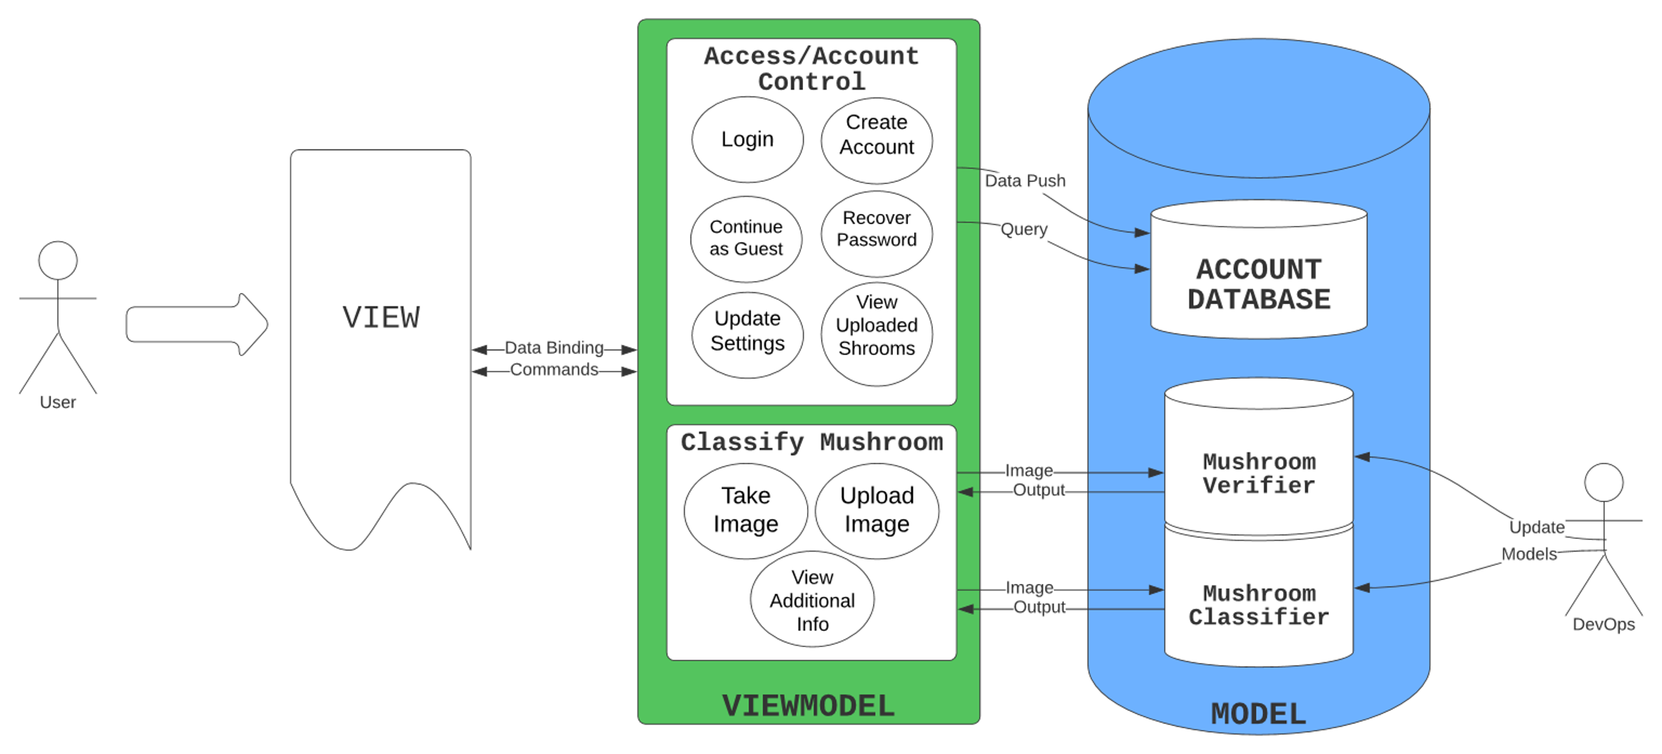
Architecture and Components
Notes:
Matthew – architectural style
Nolan – components are:
view, which contains user interface and takes input from user

Slide 7
Advantages of MVVM
Loose coupling
Facilitates unit testing.
Eases addition of future functionality.
Viewmodel handles formatting so that View doesn’t have to.
Notes:
Nolan –
Loose coupling - the model doesn’t know about the view model – all it knows is that it receives input (in this case, image data or a database query) and returns the output. Similarly, the viewmodel does not know that the view exists.
View can be simplified because it doesn’t need to know how to format output from the model. It need only “read” from the viewmodel.

Slide 8
Design Patterns
Viewmodel Functions like a façade
View can make simple commands
Neural networks objects are constructed according to the singleton design pattern
Notes:
Nolan

Slide 9
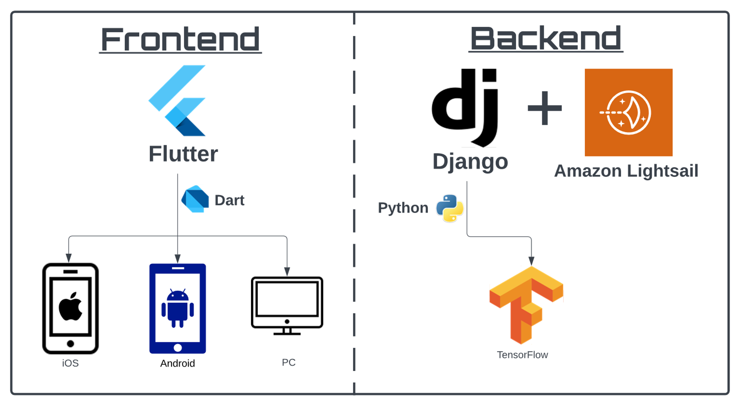
Framework
Notes:
Use case diagram here

Slide 10
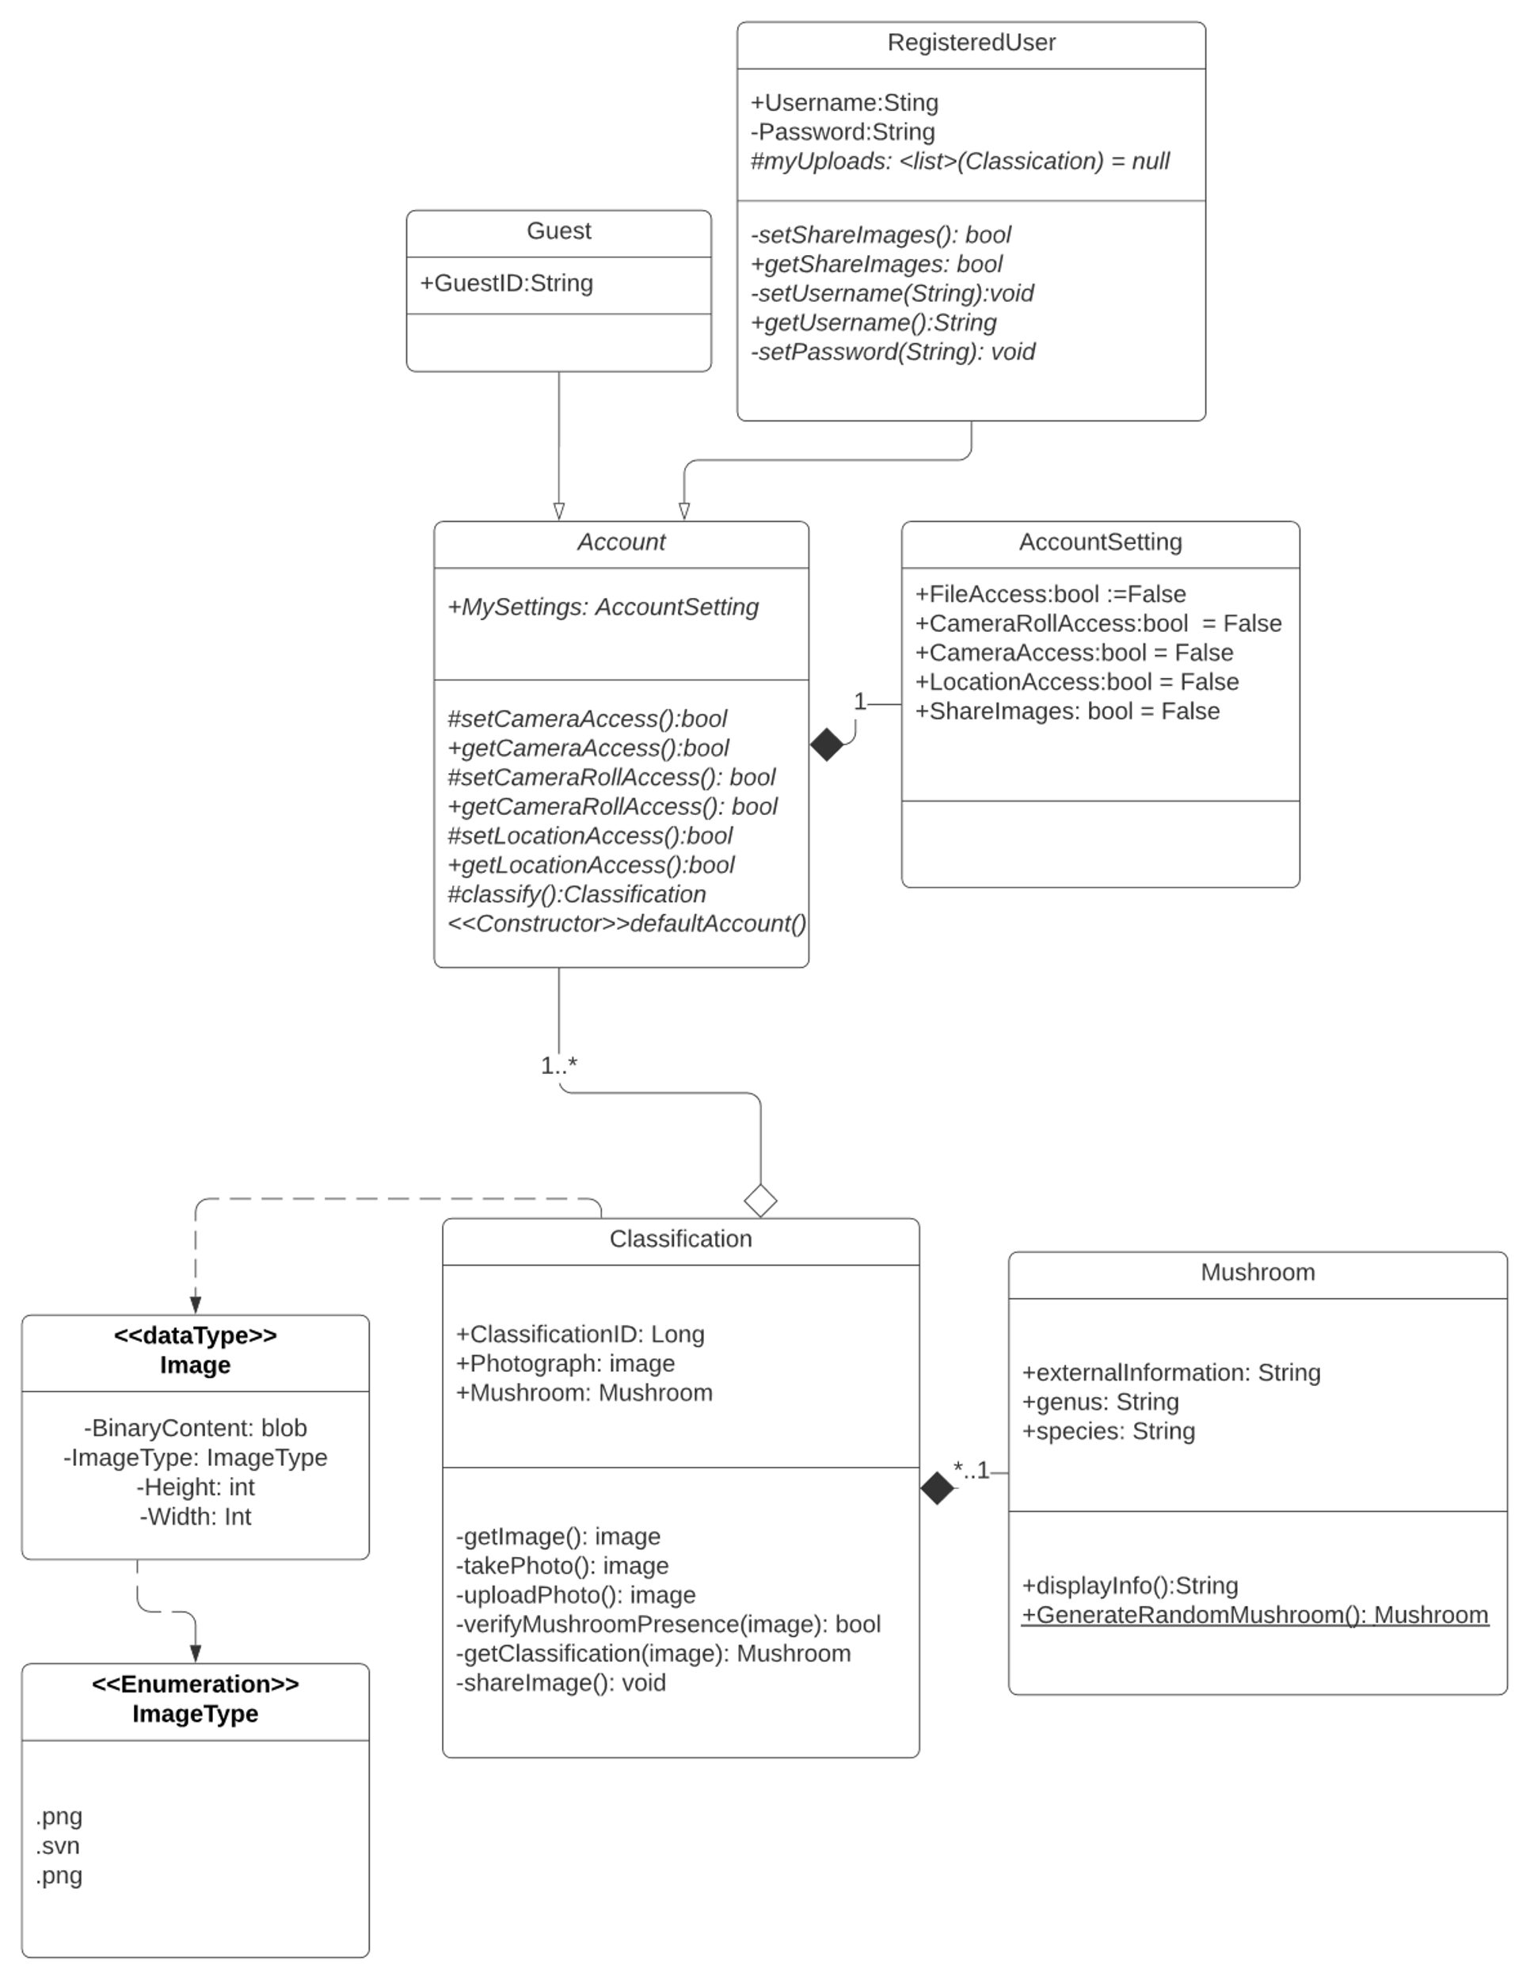
Class Diagram (part 1)
Notes:
Use case diagram here

Slide 11
Class Diagram (part 2)
Notes:
Use case diagram here

Slide 12
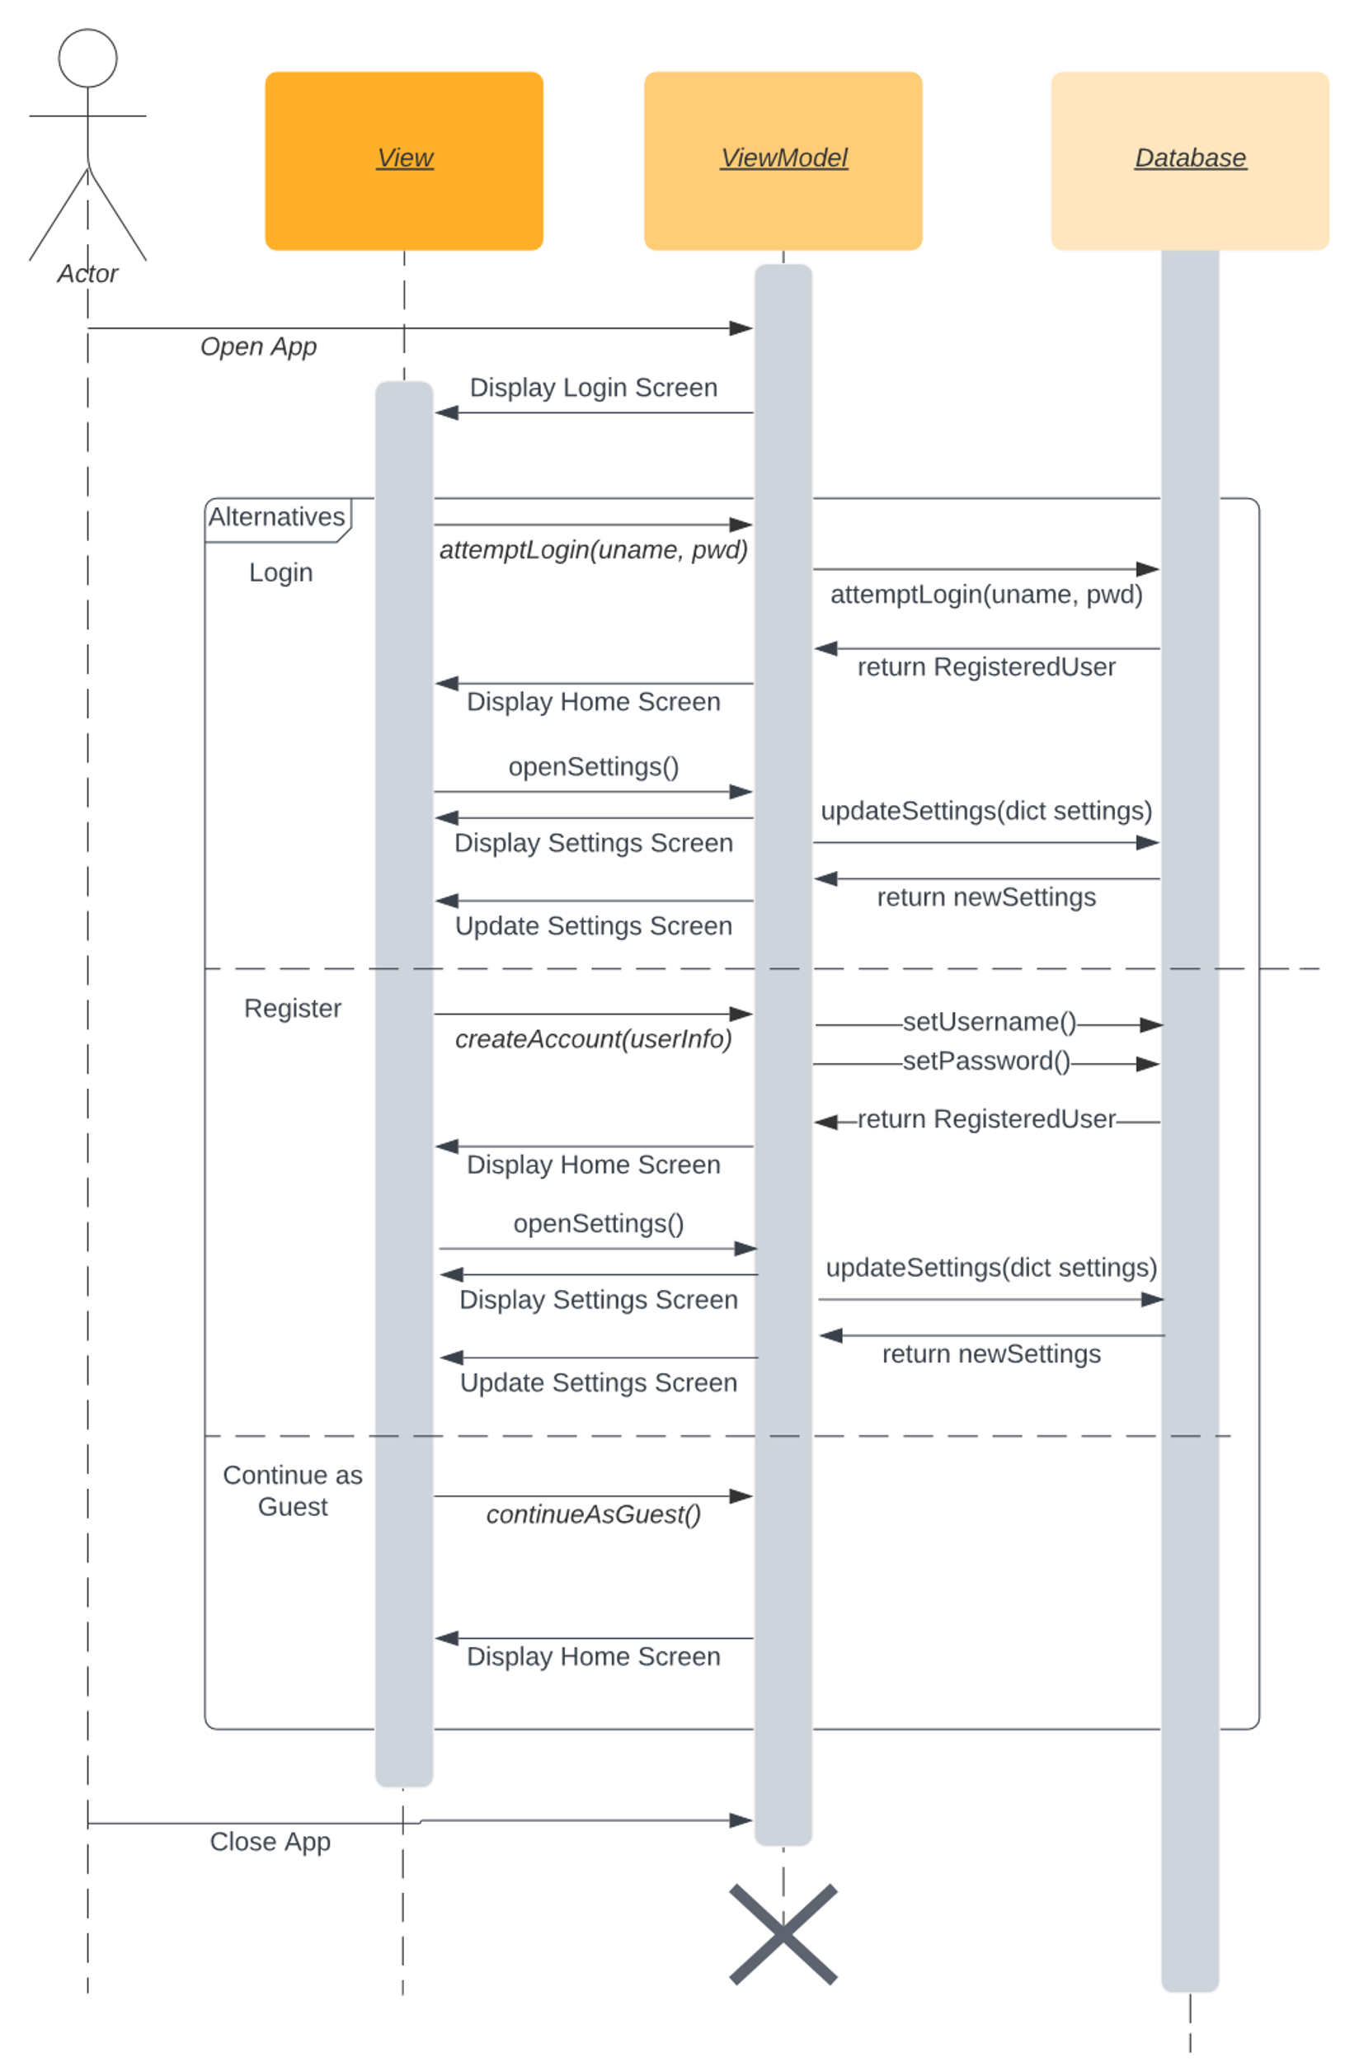
Sequence Diagram 1: Account/Access Control (part 1)
Notes:
Use case diagram here

Slide 13
Sequence Diagram 1: Account/Access Control (part 2)
Notes:
Use case diagram here

Slide 14
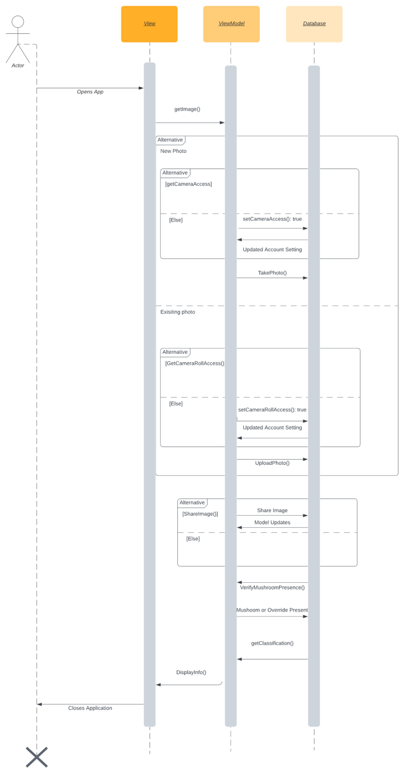
Sequence Diagram 2: Mushroom Classification (part 1)
Notes:
Use case diagram here

Slide 15
Sequence Diagram 2: Mushroom Classification (part 2)
Notes:
Use case diagram here

Slide 16
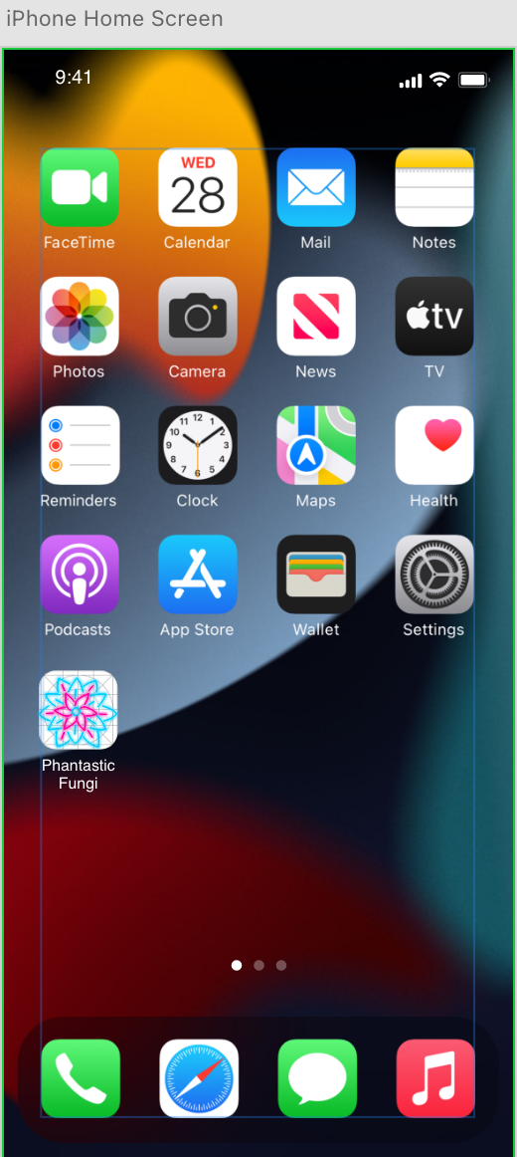
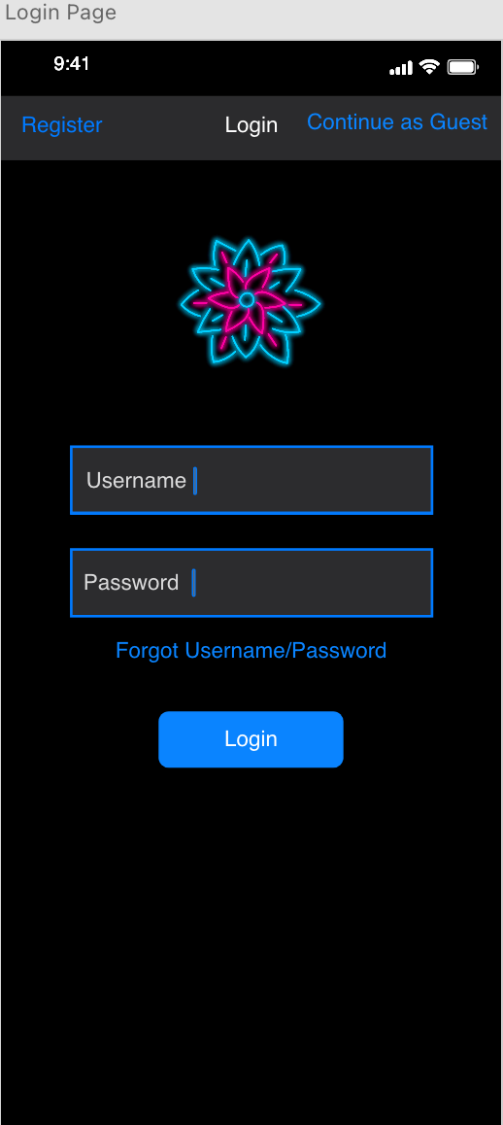
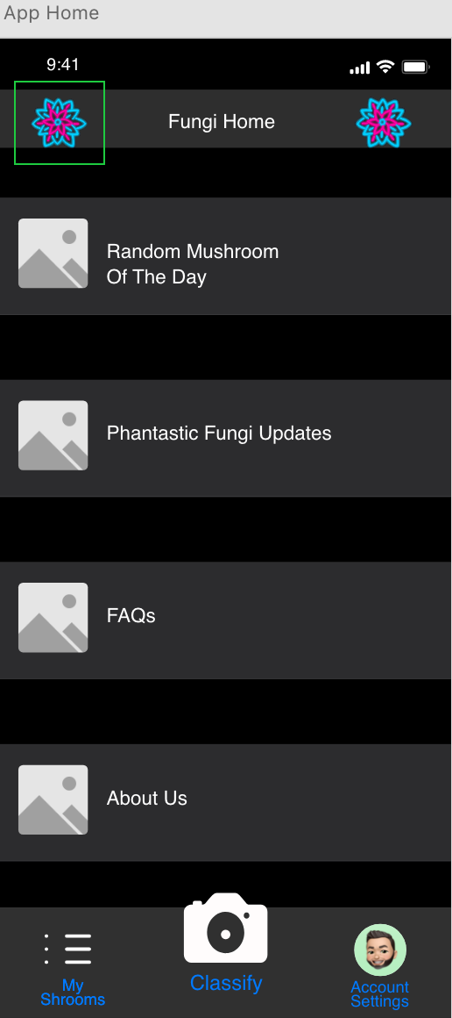
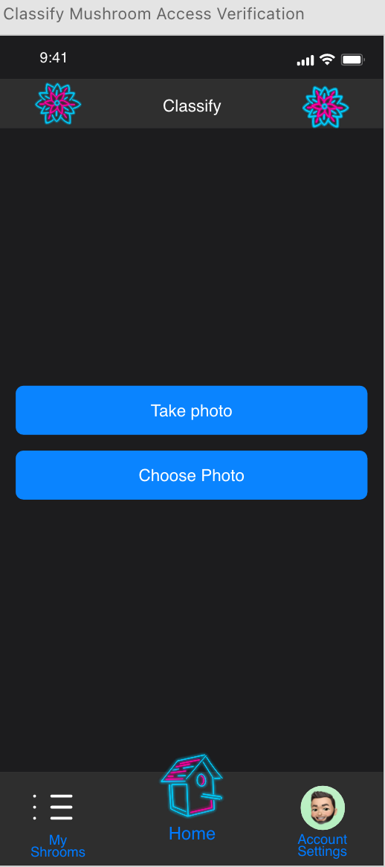
Project Mockup
Notes:
Use case diagram here

Slide 17
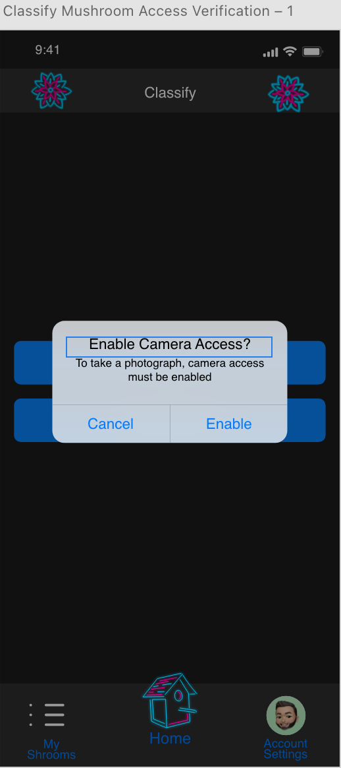
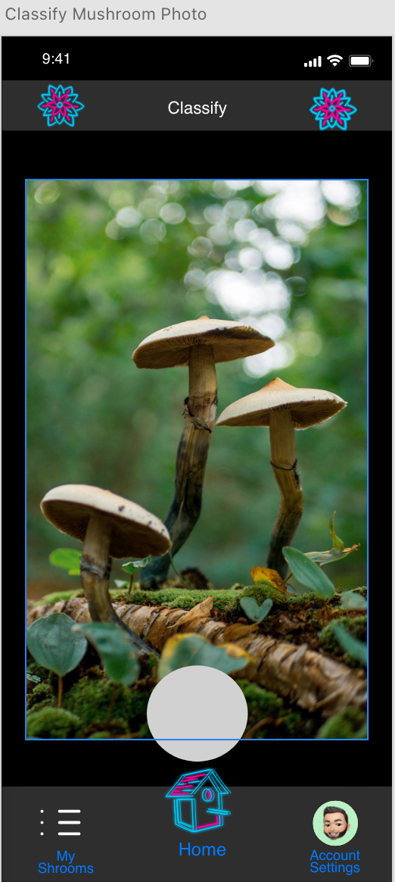
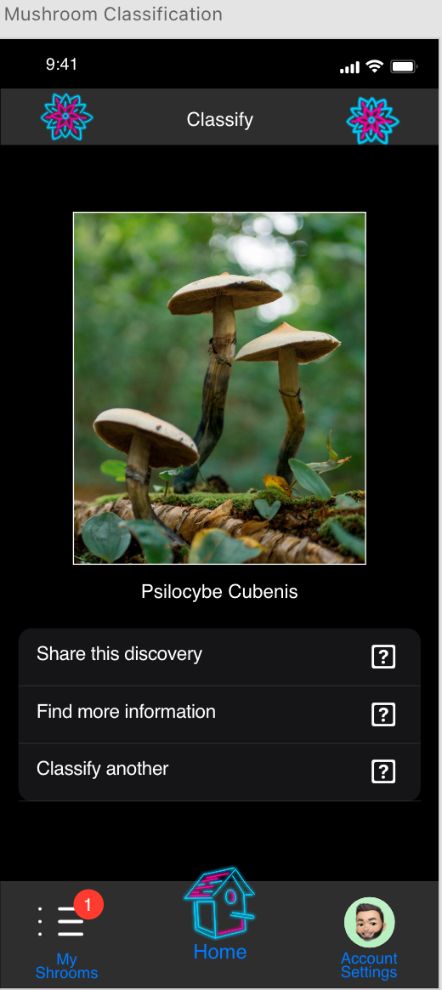
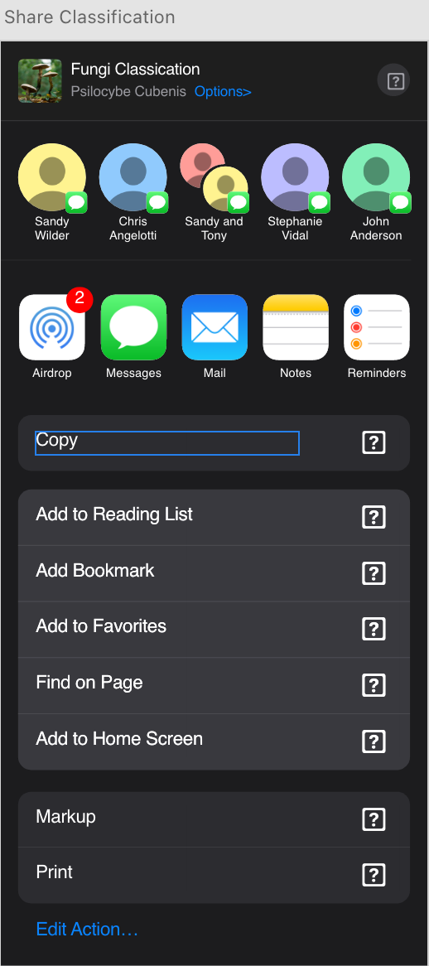

Slide 18








GitHub Link
github.com/juanca-jimi/FungiClassifier
Notes:
Use case diagram here

Slide 19
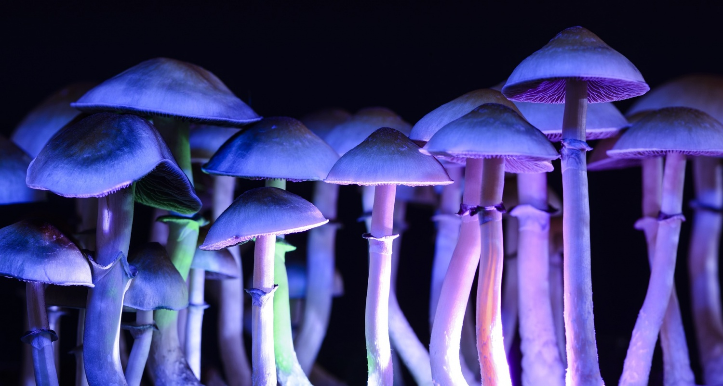
Thanks!

